Slide 1
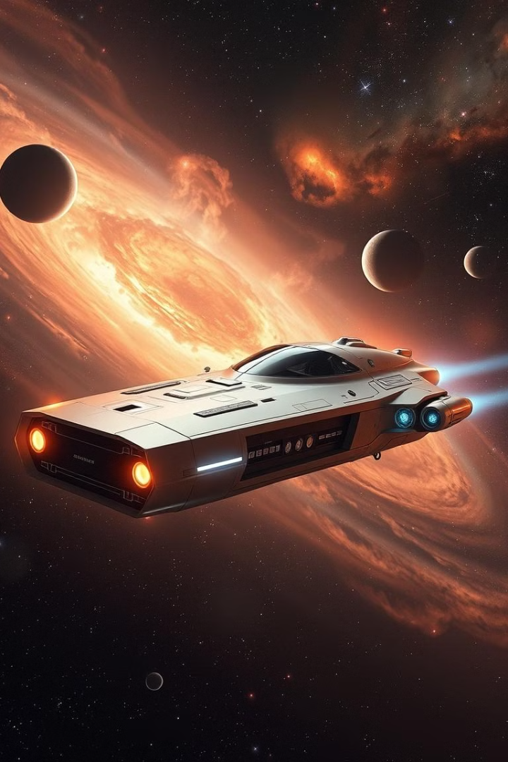
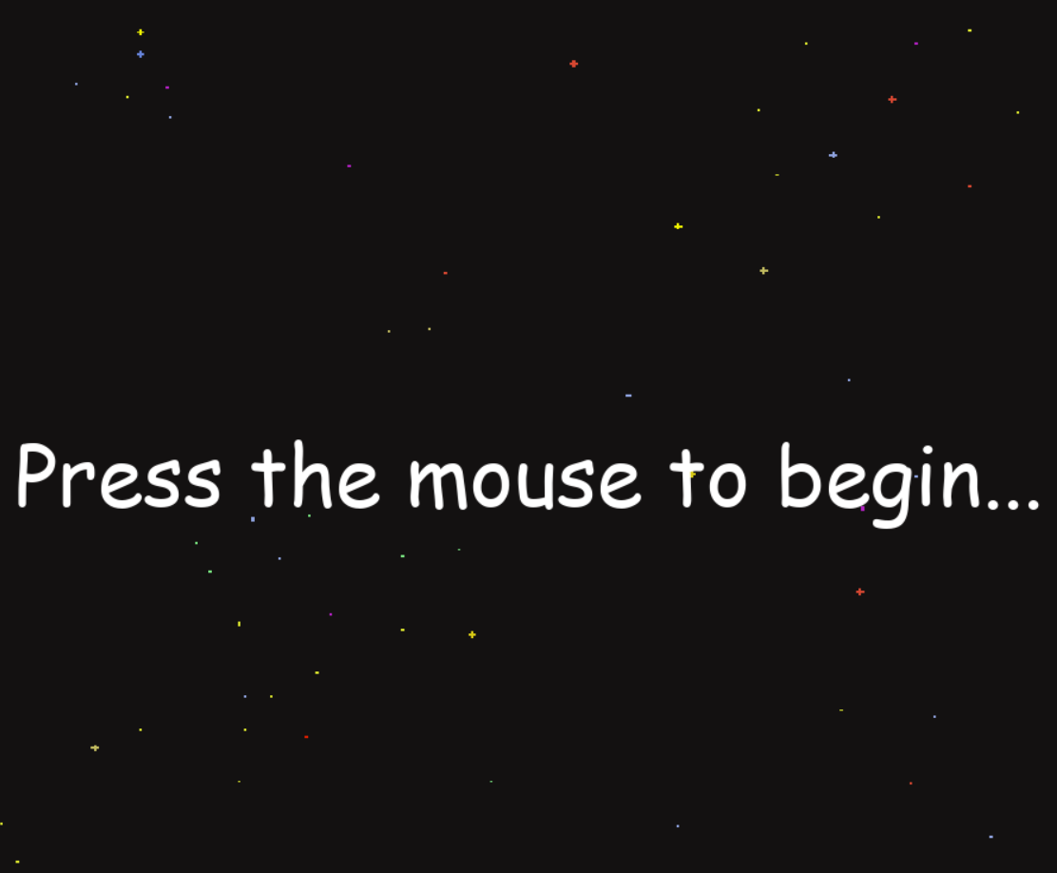


Space Shooter Game
In the space shooter game, the player takes control of a spaceship in a dynamic space environment and must avoid obstacles and defend against waves of hostile ships. Fast-paced action is emphasized in the game, and in order to score highly, players must exhibit quick reactions and clever thinking. The game adds more difficult stages as players progress, increasing replay ability and player interest.

Slide 2
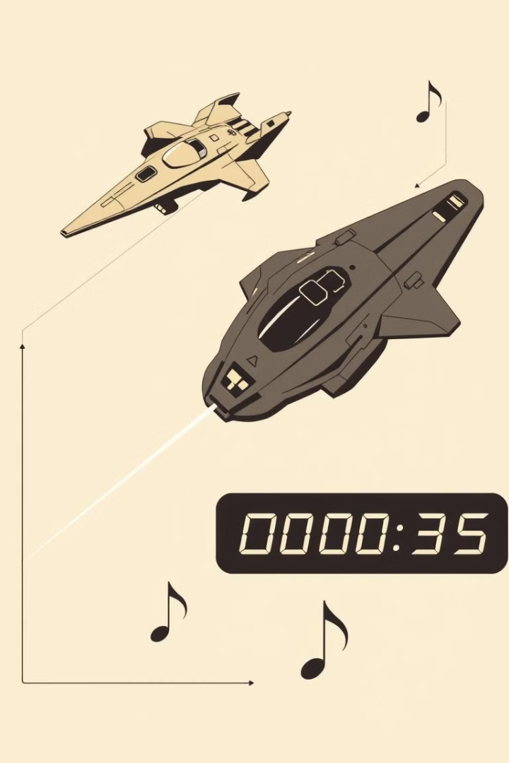
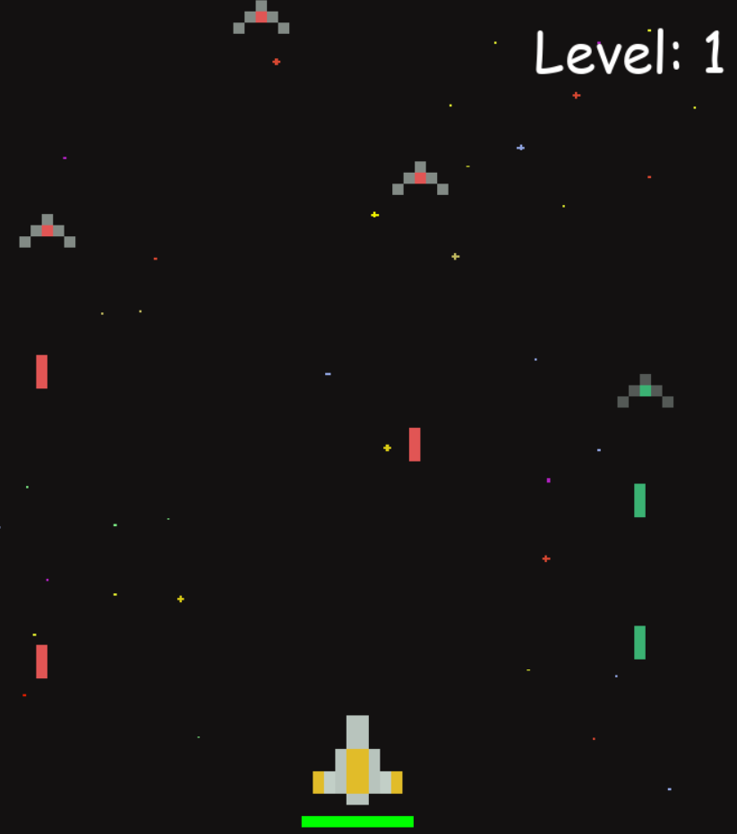
Game Components
Player Ship
Enemy Ships
The player controls a spaceship with the ability to move left, right, and fire lasers.
Enemy ships move across the screen, attempting to collide with the player's ship.
Lasers
Collision Detection
The player's ship fires lasers to destroy enemy ships, and enemy ships can also fire lasers.
The game uses collision detection to determine when the player's ship or lasers come into contact with enemy ships.

Slide 3
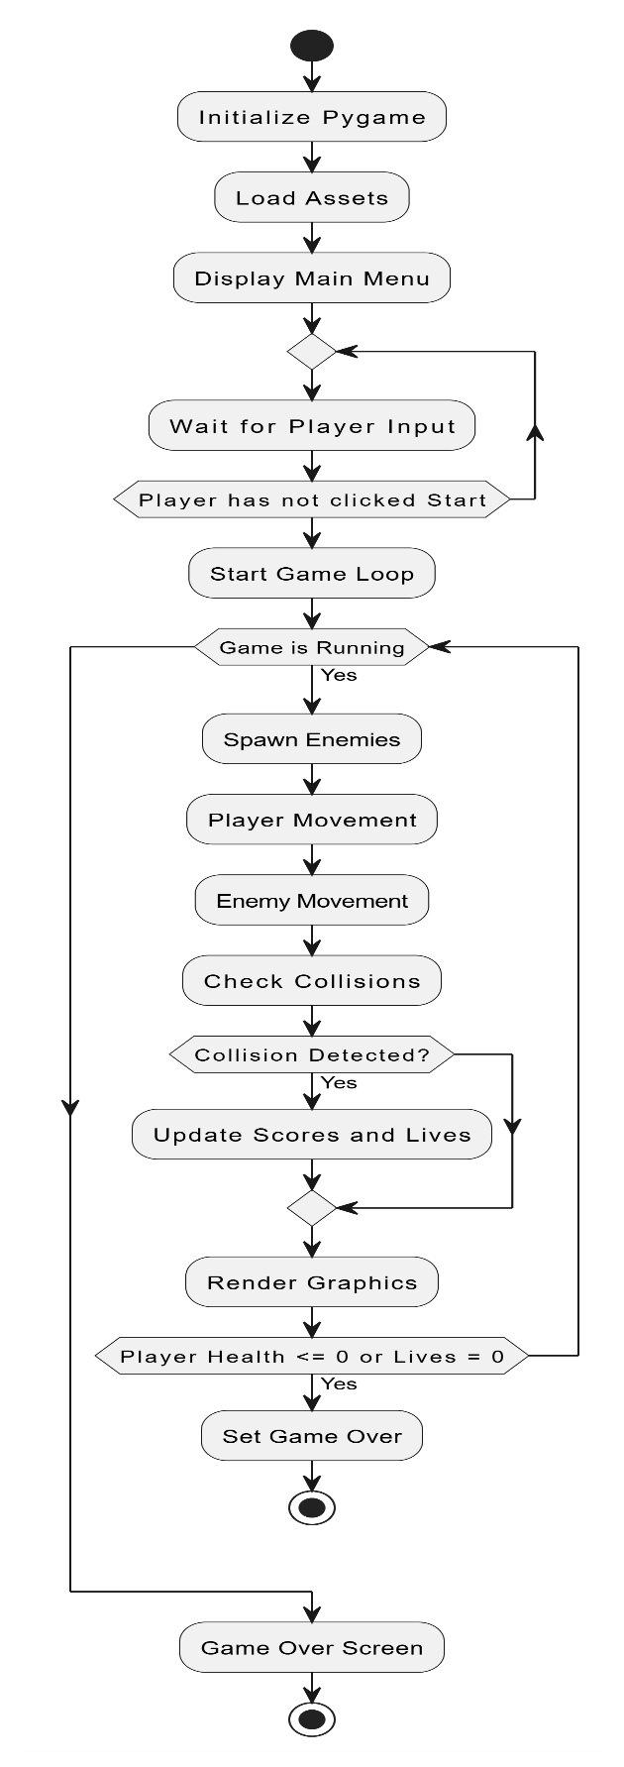

Project Design
1.Lasser Class: Projectiles launched by the player and opposing ships are represented by the Laser class. It includes functions for moving lasers (move), drawing them on the screen (draw), and determining if they are off-screen (off-screen). To identify collisions with other objects, it also has a collision method.
2.Ship Class: Acting as a basic class for all ships, Ship specifies common characteristics like health, location (x, y), and a laser cooldown mechanism. It contains methods for shooting lasers (fire), moving lasers (move lasers), and drawing the ship and its lasers (draw). Additionally, it has useful functions for managing sprite dimensions, such as get width and get height. 3.Player Class: This class modifies the player's ship and inherits from Ship. It modifies move lasers to handle collisions with adversaries in particular and adds ways for controlling the health meter (health bar). This is where the player loads and assigns their ship sprite and laser.
4.Enemy Class: This class builds upon Ship and specifies special actions for adversary ships, such as shooting (shot) and moving (move). It distinguishes between different opponent classes and their corresponding sprites and lasers using a color-coded mapping scheme.

Slide 4
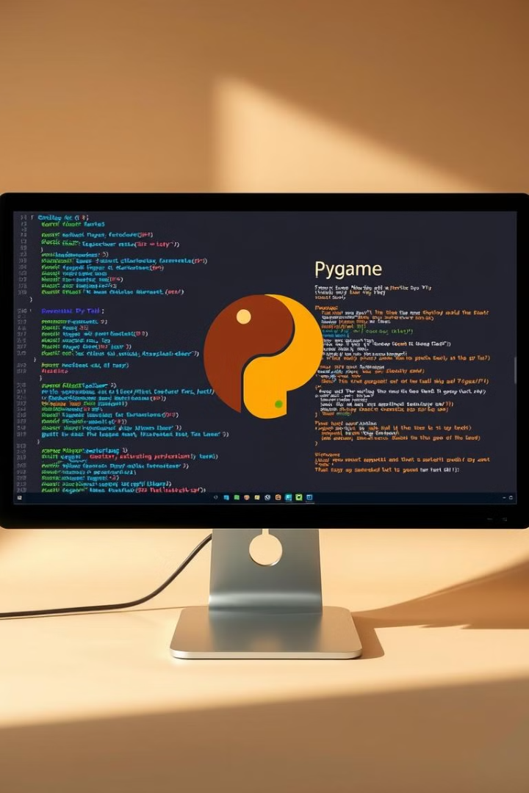
Game Development with Pygame
Objectives
Scope
1.Game mechanics: Create responsive and fluid player controls for the spaceship's firing, mobility, and collision avoidance. 2.Enemy AI: Construct increasingly difficult enemy ships with different characteristics and patterns of movement. 3.Level Design: Use a system of level advancement to make the game harder as the player gets better. 4.System of Scoring: Create a system of scoring to monitor player performance and promote high-scoring accomplishments.
This project's scope involves using the Pygame library to create a fully working game engine. Important game development ideas including event handling, sprite management, collision detection, and frame rate control will all be illustrated in this project. A well-designed user interface with options to start, pause, and display top scores will also be included in the game.

Slide 5
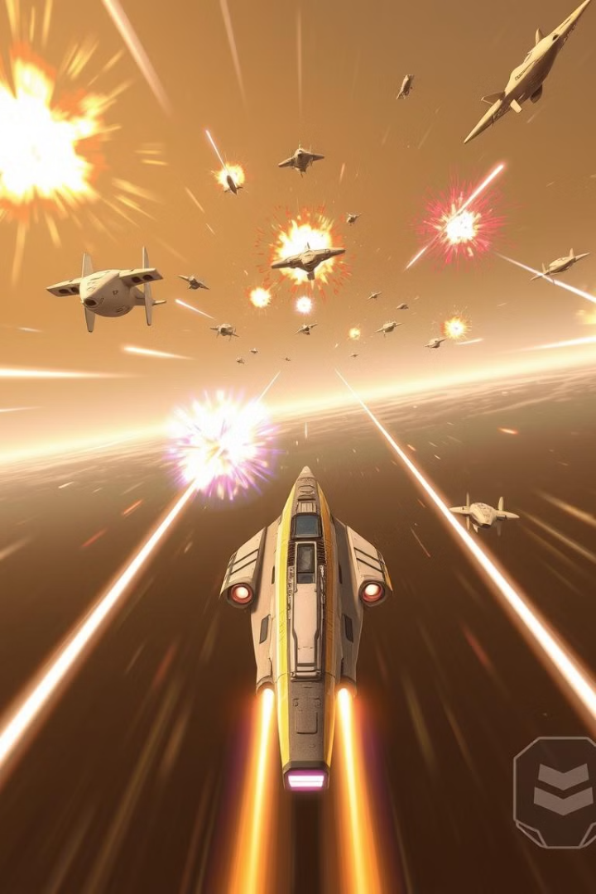




Gameplay Mechanics
Navigation
Shooting
The player uses the arrow keys to move the ship left, right, and up and down.
The player uses the spacebar to fire lasers, destroying enemy ships and earning points.
Scoring
Game Over
The player earns points for each enemy ship destroyed, with bonus points awarded for speed and accuracy.
The game ends when the player's ship is hit by an enemy ship or laser, with the final score displayed.

Slide 6
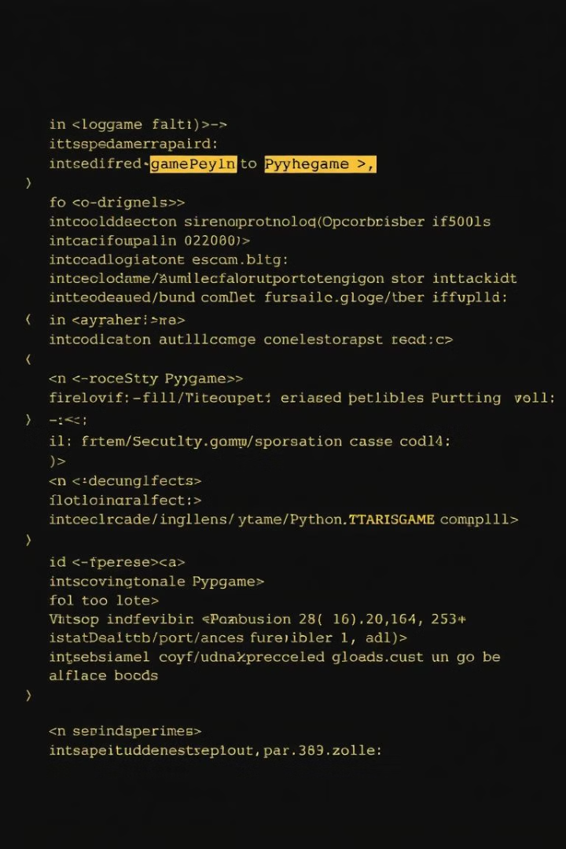
Technical Implementation
1
The game logic is implemented using Pygame's event handling system and game loop.
2
The game's visual elements, such as the spaceship, enemy ships, lasers, and background, are created using Pygame's sprite and surface classes.
3
Pygame's sound library is used to implement background music and sound effects, adding to the immersive experience.

Slide 7
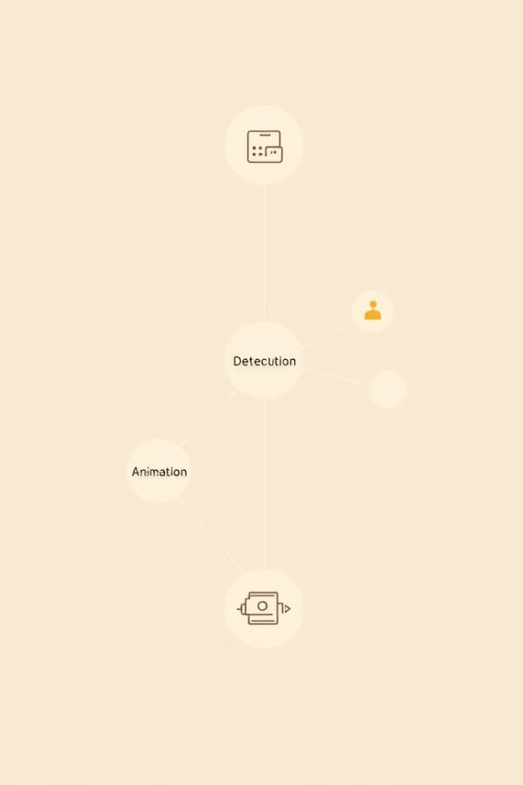



Challenges and Solutions
Collision Detection
Ensuring accurate collision detection between the player's ship, lasers, and enemy ships was a significant challenge.
Animation
Achieving smooth animation for the spaceship, enemy ships, and lasers required careful implementation of Pygame's animation features.
User Interface Design
Designing an intuitive and visually appealing user interface for the game, including menus and score displays, was a priority.

Slide 8




Future Enhancements
Level Design
1
Implement different levels with increasing difficulty, introducing new enemies and obstacles.
Power-Ups
2
Add power-ups that enhance the player's ship abilities, such as faster movement, stronger lasers, or temporary shields.
Multiplayer Mode
3
Introduce a multiplayer mode where players can compete against each other in a space battle.

Slide 9



Conclusion
Game Development
1
Pygame is a powerful and versatile tool for creating engaging 2D games.
Success
2
The space shooter game is a testament to Pygame's capabilities and my abilities as a developer.
Future
3
This project has opened up new possibilities for exploring more complex game mechanics and designs.

Slide 10
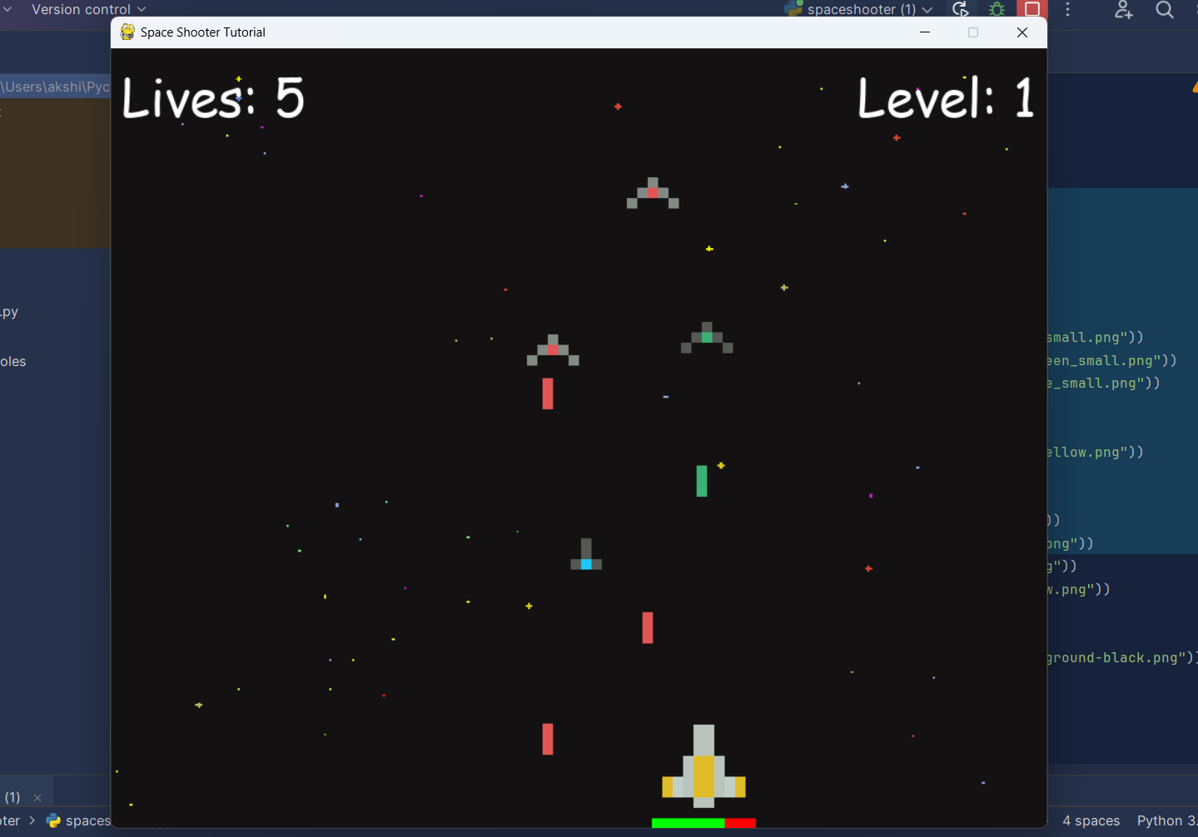

Thank You

